Slide 1
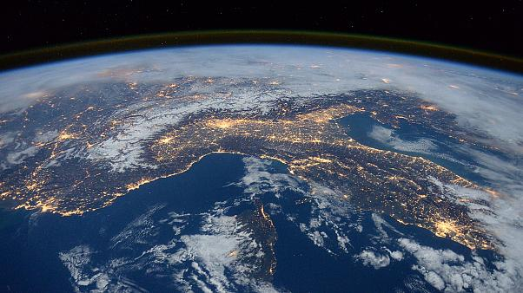
AQI & COVID Tracking Map
Nurgazy Seidaliev, Andriy Lunin, Daniella Aruina

Slide 2
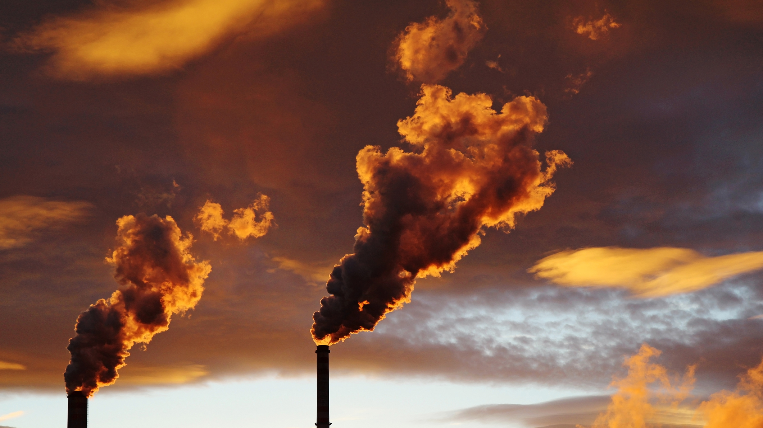
PROBLEM
60,000+
15.5 MN+
290,000+
Total deaths due to combustion emissions¹
Total number of COVID-19 cases²
Total number of COVID-19 deaths³
1 - Statista, 2019.
2 - December 2019.
3 - December 2019.

Slide 3
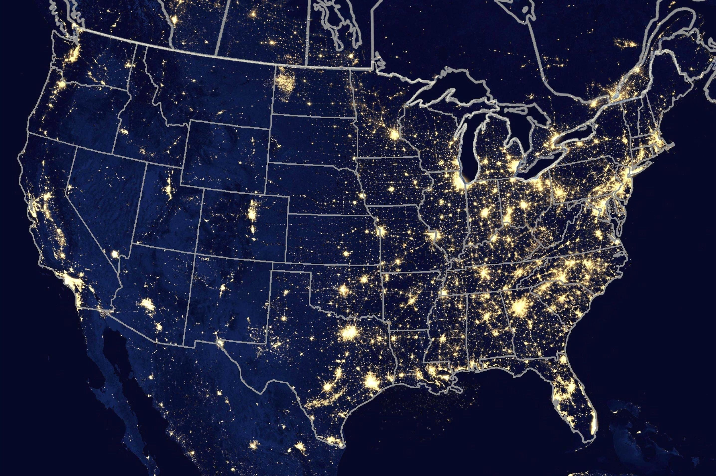
SOLUTION
Interactive Map
Get weekly 2020 information on COVID-19 cases and Air Quality Index (AQI) for each state

Slide 4
HOW IT WORKS
Access the interactive map website
Scroll through weekly periods to see how each state has been affected by COVID-19 and air quality
Understand the relationship between COVID-19 and AQI

Slide 5

OUR WORK
STAGE 1
STAGE 2
STAGE 3
Data Cleaning
Data Analysis
Deployment

Slide 6
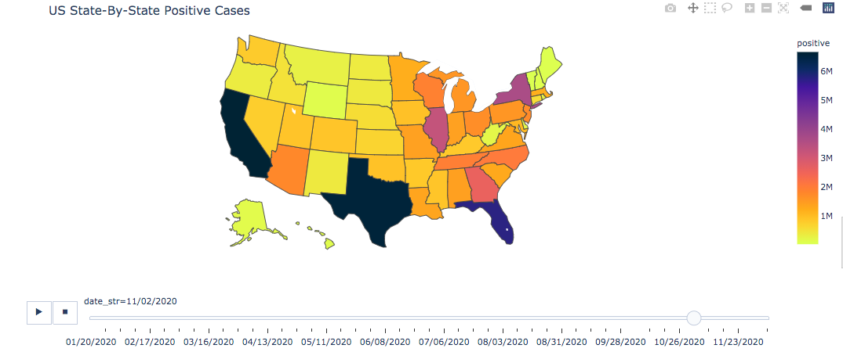
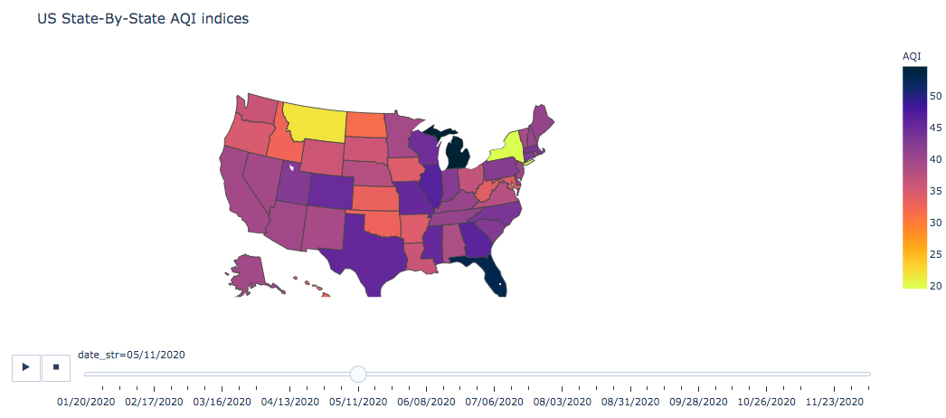
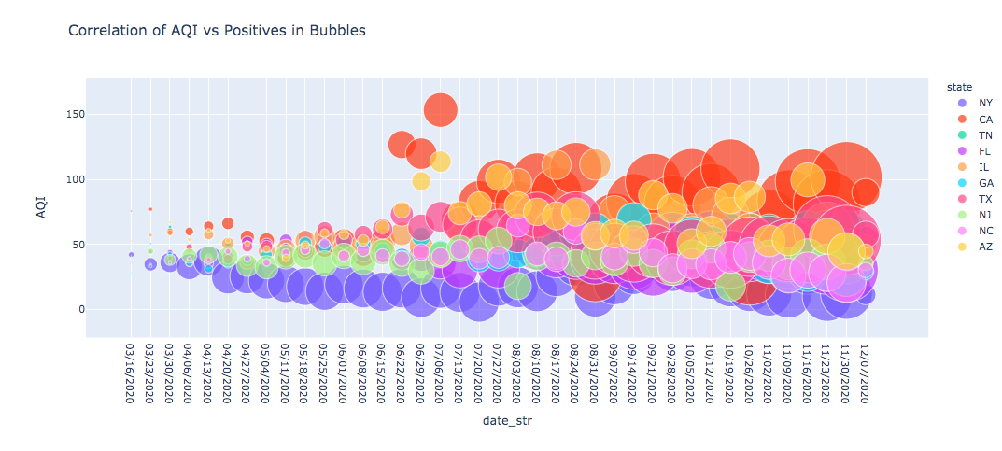
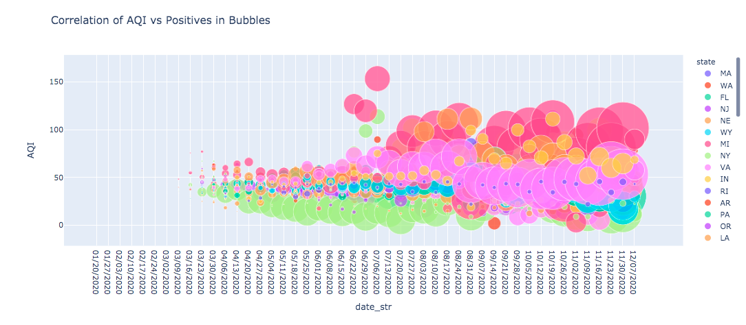
PROTOTYPE

Slide 7

THANK YOU!

